Slide 1
Operations Research
CSC 434
Lecture 1
Oluwambo Olowe

Slide 2
COURSE OUTLINE
History of Operations Research, Models: approaches and reasons for. Overview of Linear programming. Graphical approach to solving linear programming problems. Simplex method: problem formulation and solution (use 3 variables problems), Duality. Assignment and Transportation Algorithms. Problem Formulation and solution using these algorithms.
Materials:
Introduction to Operations Research: Theory and Application (Halidi Lyeme & Mohamed Seleman)
OPERATIONS RESEARCH THEORY AND APPLICATIONS (6Ed). J K SHARMA

Slide 3
Operations Research
      Definition
Generally speaking, operations research is an approach to the analysis of operations that adopts:
Scientific method (observation, hypothesis, deduction and experimentation).
The explicit formulation of complex relationships.
An inter-disciplinary nature.
A non-partisan attitude.

Slide 4
Background (History of Operation Research)
Pre-World war II:
Though the roots of OR extend to even early 1800s, it was in 1885 when Ferderick W. Taylor emphasized the application of scientific analysis to methods of production. Also Henry L. Gantt proposed the mapping of each job from machine to machine, minimizing every delay. With the Gantt procedure it is possible to plan machine loadings months in advance and still quote delivery dates accurately. In 1917, A.K.Erlang, a Danish mathematician, published his work on the problem of congestion of telephone traﬃc. The diﬃculty was that during busy periods, telephone operators were many, resulting in delayed calls. A few years after its appearance, his work was accepted by the British Post Oﬃce as the basis for calculating circuit facilities. The well-known economic order quantity model is attributed to F.W. Harris, who published his work on the area of inventory control in 1915.
During the 1930s, H.C. Levinson, an American astronomer, applied scientific analysis to the problems of merchandising. His work included scientific study of customers’ buying habits, response to advertising and relation of environment to the type of article sold.

Slide 5
,
However, it was the First Industrial Revolution which contributed mainly towards the development of OR. Before this revolution, most of the industries were small scale, employing only a handful of men. The advent of machine tools as a source of power and improved means of transportation and communication resulted in fast flourishing industry. It became increasingly diﬃcult for a single man to perform all the managerial functions (of planning, sale, purchase, production, etc.). Consequently, a division of management function took place. Managers of production, marketing, finance, personnel, research and development etc., began to appear. With further industrial growth, further subdivisions of management functions. For example, production department was sub-divided into sections like maintenance, quality control, procurement, production planning, etc.

Slide 6
,
World War II:
During World War II, the military management in England called on a team of scientists to study the strategic and tactical problems of air and land defenses. This team was under the direction of Professor P.M.S. Blackett of University of Manchester and a former naval oﬃcer. ‘Blackett circus’, as the group was called, included three physiologist, two mathematical physicists, one astrophysicist, one army oﬃcer, one surveyor, one general physicist and two mathematicians. Many of these problems were of the executive type. The objective was to find out the most eﬀective allocation of limited military resources to the military operations and to the activities within each operation. The application included the eﬀective use of newly invented radar, allocation of British Air Force Planes to missions and the determination of best patterns for searching submarines. This group of scientists formed the first OR team.

Slide 7
,
The name operations research (or operational research) was apparently coined because the team was carrying out research on (military) operation. The encouraging results of these eﬀort led to the formation of more such teams in British armed services and the use of scientific teams soon spread to western allies - the United States, Canada and France. The United States, however soon took the lead, as these OR teams helped in developing strategies from mining operations, inventing new flight patterns and planning of sea mines.
Post-world war II
Immediately after the war, the success of military teams attracted the attention of industrial managers who were seeking solutions to their problems. Industrial operation research in U.K. and U.S.A. developed along diﬀerent lines. In U.K., the critical economic situation required drastic increase in production eﬃciency and creation of new markets. Nationalization of a few key industries further increased the potential field for OR. Consequently OR soon spread from military to government, industrial, social and economic planning. In U.S.A. the situation was diﬀerent. Impressed by its dramatic success in U.K., defense operations research in U.S.A was increased. Most of the war experienced OR workers remained in military service. Industrial executives did not call for much help because they were returning to the peace-time situation and many of them believed that it was merely a new application of an old technique. Operations research went by a variety of names in that country such as operational analysis, operation evaluation, systems analysis, system evaluation, system research and management science.

Slide 8
,
The progress of industrial operational research in U.S.A. was due to the advent of the second industrial revolution which resulted in automation around the 1940s when electronic computers became commercially available. But for these digital computers, operation research with its complex computational problems could not have achieved its promising place in all kinds of operational environments.
In 1950, OR was introduced as a subject for academic study in American universities since then this subject has been gaining ever increasing importance for the students of Mathematics, Statistics, Commerce, Economics, Management and Engineering. To increase the impact of operation research, the Operations Research Society of America was formed in 1950. In 1953, the Institute of Management Sciences (IMS) was established. Other countries followed suit and in 1959 International Federation of OR began to appear.
Today, the impact of operations research can be felt in many areas. This is shown by the ever-increasing number of educational institutions oﬀering this subject at degree level. Of late, OR activities have spread to diverse fields such as hospitals, libraries, Planning, transportation systems, management, defense, etc

Slide 9
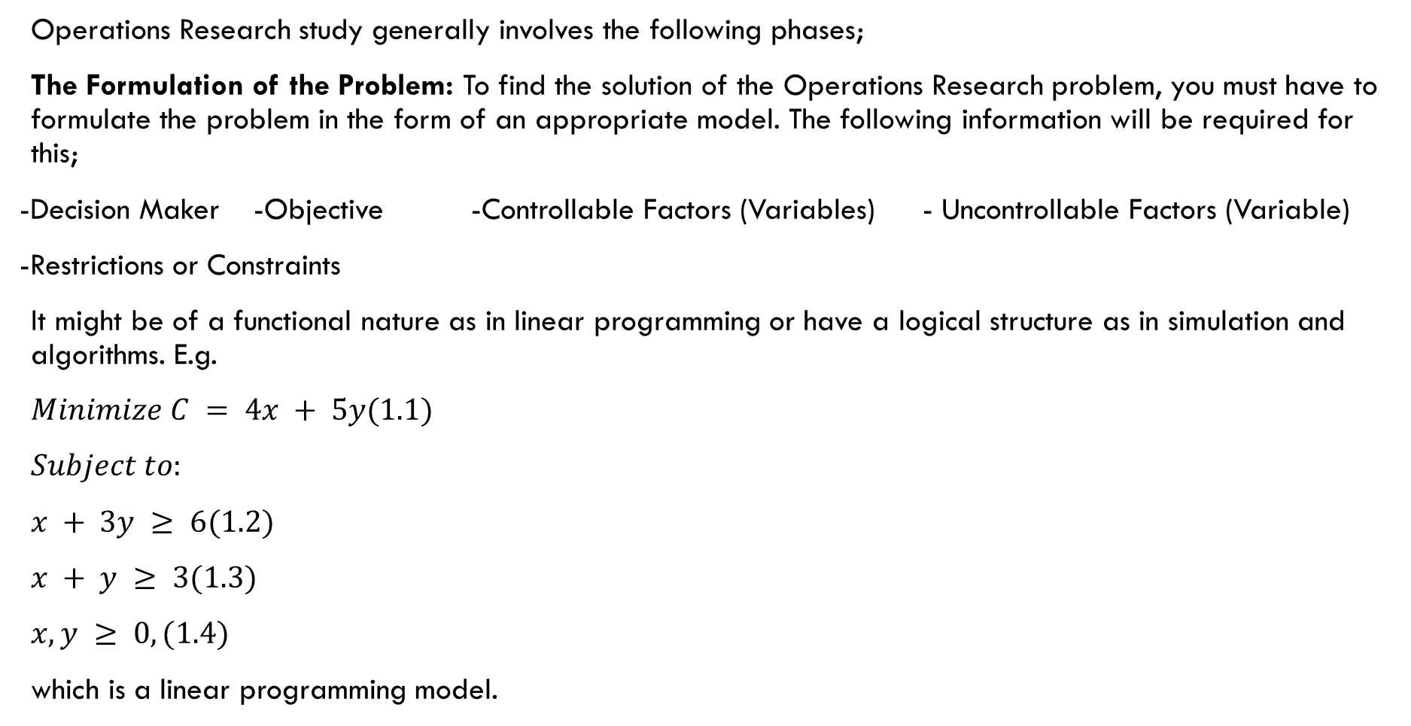
Phases of Operations Research
Operations Research study generally involves the following phases;
The Formulation of the Problem: To find the solution of the Operations Research problem, you must have to formulate the problem in the form of an appropriate model. The following information will be required for this;
-Decision Maker -Objective -Controllable Factors (Variables) - Uncontrollable Factors (Variable)
-Restrictions or Constraints
It might be of a functional nature as in linear programming or have a logical structure as in simulation and algorithms. E.g.
$Minimize C = 4x + 5y(1.1)$
$Subject to:$
$x + 3y ≥ 6(1.2)$
$x + y ≥ 3(1.3)$
$x, y ≥ 0,(1.4)$
which is a linear programming model.

Slide 10
,
Data Collection: It involves obtaining quantitative data either from existing records or a new survey that fits well into the constructed model of the problem.
Driving the Solution from the Model: This involves the manipulation of the model to arrive at the best (optimal) solution to the problem. It may require solving some mathematical equations for optimal decisions as in calculus or linear programming models. It may also be a logical approach or a functional approach which does not require solving a mathematical equation, such as in queuing theory. The optimal solution is then determined by some criteria.
Testing the Model and Its Solution: After getting solution, it is necessary to test the solution for errors if any. This may be done by re-examining the formulation of the problem and comparing it with the model that may help to reveal any mistakes.

Slide 11
,
Controlling the Solution: This phase establishes controls over the solution with any degree of satisfaction. The model requires immediate modification as soon as the controlled variables (one or more) change significantly, otherwise the model goes out of control. As the conditions are constantly changing in the world, the model and the solution may not remain valid for a long time.
Implementation of Model: The final phase of an Operations Research is to implement the optimum solution derived by the Operations Research team. As the conditions are constantly changing in the world, the model and the solution may not remain valid for a long time. Therefore, as the change occurs, it has to be detected as soon as possible so that the model, its solution and the resulting course of action can be modified accordingly. See the figure below

Slide 12
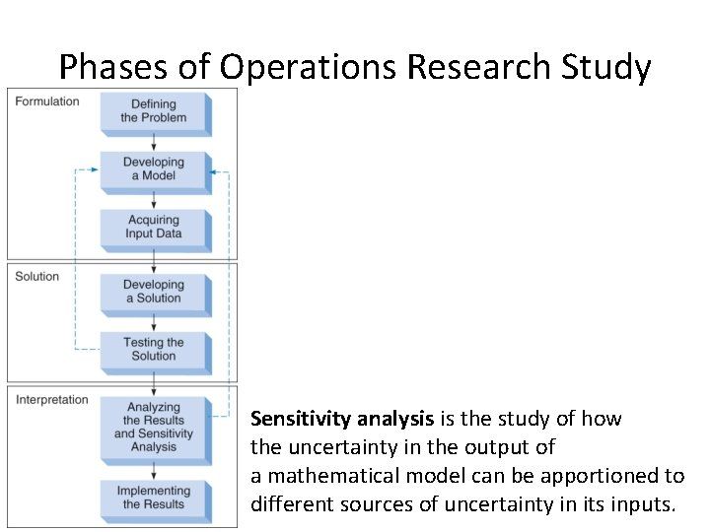
,

Slide 13
Quantitative Techniques of Operation Research
Operation Research as its name suggests, focuses on analysis of operations as a whole. For this purpose, it uses any suitable techniques or tools available from the fields of mathematics, statistics, cost analysis or numerical calculations. Some of these techniques are listed below;
Linear Programming
Non-linear Programming
Integer Programming
Dynamic Programming
Goal Programming
Game Theory
Inventory Control
Simulation
Queuing Theory

Slide 14
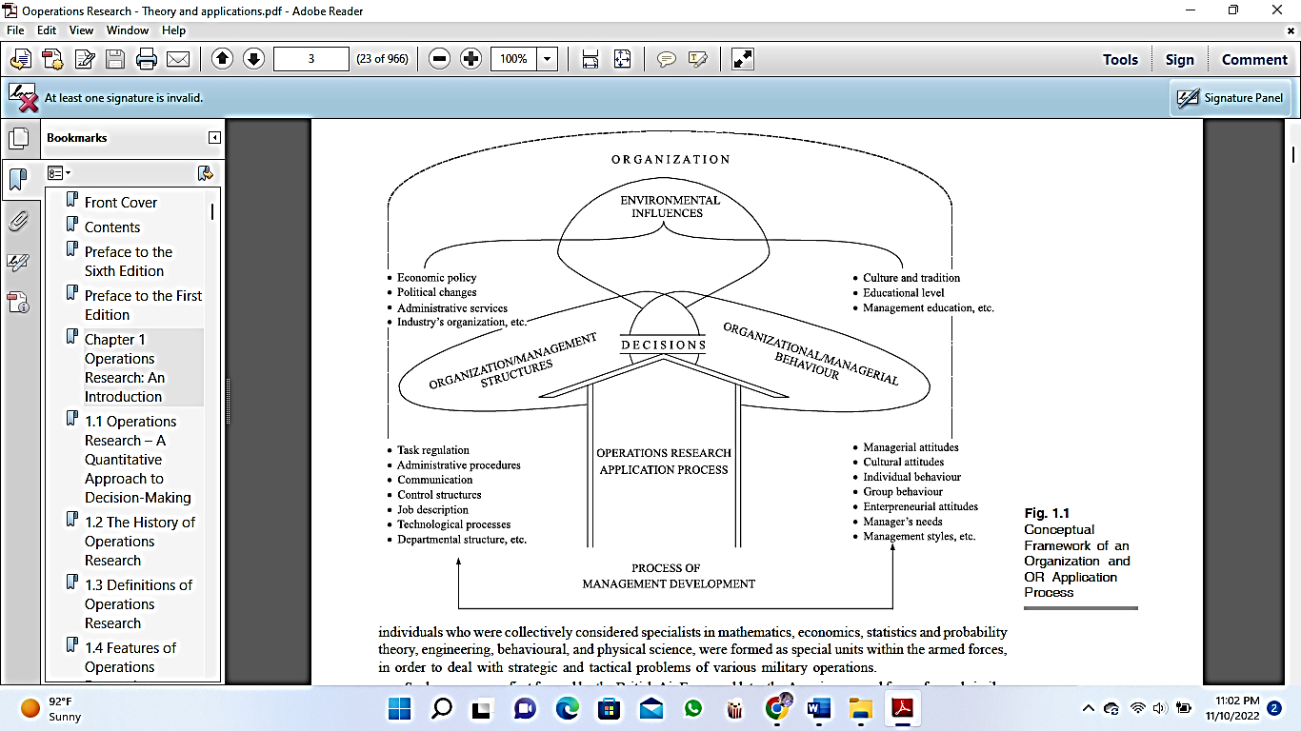
Scope of Operation Research
Conceptual framework of an organization and OR application process

Slide 15
,
In Agriculture: Operation Research needs to be equally developed in agriculture sector both on national and international scale. Every country is facing the problem of optimum allocation of land to various crops in accordance with the climatic conditions and optimum distributions of water from various resources like canal for irrigation purposes. Thus, there is a need of determining best policies under the prescribed restrictions.
In Public Utilities: Operation Research is directly applicable to business and society. It is also equally applicable for big and small organization. It has been extensively used in petroleum, paper chemical, metal processing, aircraft, transport and distribution, mining and textile industries.

Slide 16
Model in Operation Research
When we present a real-life situation in some abstract form whether physical or mathematical, bringing out the relationships of its important ingredients, we call it model. Thus, model need not describe all the aspects of this situation, but it should signify and identify important factors and their interrelationships to describe the total situation. There are number of models used in Operation Research. Some of the basic types are described below.
Physical Models: These models provide a physical appearance of the real object under the study of either reduced in size or scaled up. Physical models are useful only in design problems because they are easy to observe, build and describe. Physical models are classified into the following two categories.
Iconic Models: These models represent the system as it is but in diﬀerent size. Thus, Iconic Models are obtained by enlarging or reducing the size of the system. In other words, they are images, examples of iconic models are blueprints of a home, maps, globes, photographs, drawings, air planes, trains, etc.
Analogy Models: These models do not look like the real situation but rep-resent and behave like a system under study. For example, the organiza-tion chart represents the structure, authority and responsibilities relationship with boxes and arrows and maps in diﬀerent colors represent water, desert and other geographical features.

Slide 17
,
Symbolic Models: These models use symbols (i.e letters, numbers) and functions to represent variables and their relationship to describe the properties of the system. These models are also used to represent relationships which can be represented in a physical form. Symbolic models can be classified into two categories.
Verbal Models: These models describe a situation in written or spoken language. Written sentences, books, etc. are examples of verbal models.
Mathematical Models: These models involve the use of mathematical symbols, letters, numbers and mathematical operators (+, -, x,) to represent relationships among various variables of the system to describe its properties or behaviour.
Heuristic Models: These models use intuitive rules or guidelines to solve a particular problem. These models are not based on any definite mathematical expression or relationships, but problem solving based on past experience or approach formulated on the basis of definite stepped procedure. These models need an ample amount of creativity and experience by the decision maker.

Slide 18
Advantages and Limitations of Operation Research
Operation Research is useful for improving quality of managerial decision making. By using various tools and techniques of Operation Research we can get optimal solution of the problem. However, besides certain advantages, Operation Research has some limitations.
Advantages
It compels the decision maker to be explicit about his objective, assumptions and his perspective to constraints.
It makes the decision maker to be very carefully about what variables influence the decisions.
Quickly points out gaps in the data required to support workable solutions to a problem.
Its models can be solved by a computer; thus, the management can get enough time for decisions that require quantitative approach.
Drawbacks
Often solution to a problem is derived either by making it simplified or simplifying assumptions and thus, such solutions have limitations.
Sometimes models do not represent the realistic situations in which decisions must be made.
Often a decision maker is not fully aware of the limitations of the models that he is using.
Many real-world problems just cannot have an OR solution.

Slide 19
Applications of Operation Research
Some of the industrial/government/business problems which can be analysed by OR approach have been arranged by functional areas as follows;
Finance and Accounting
  Marketing
  Production Management
  Personnel Management
  Techniques and General Management
  Stock re-ordering policies
  Transport schedules
  Product mix and Production flows
  Allocation problems i.e. which jobs should be allocated to which machines
  Time wasted queuing at issuing, counters
  Scheduling of activities in a complex project
  General congestion problem.

